Slide 1
Cooling Issues January 2022 - detector closing
Oleg Solovianov
Ludovico Pontecorvo
Stanislav Nemecek
Antonio Cervello Duato
Merve Nazlim Agaras
Dawit Mesfin Belayneh
Katherine Rees Hughes
Filipe Manuel Pedro Martins
Irakli Minashvili

Slide 2
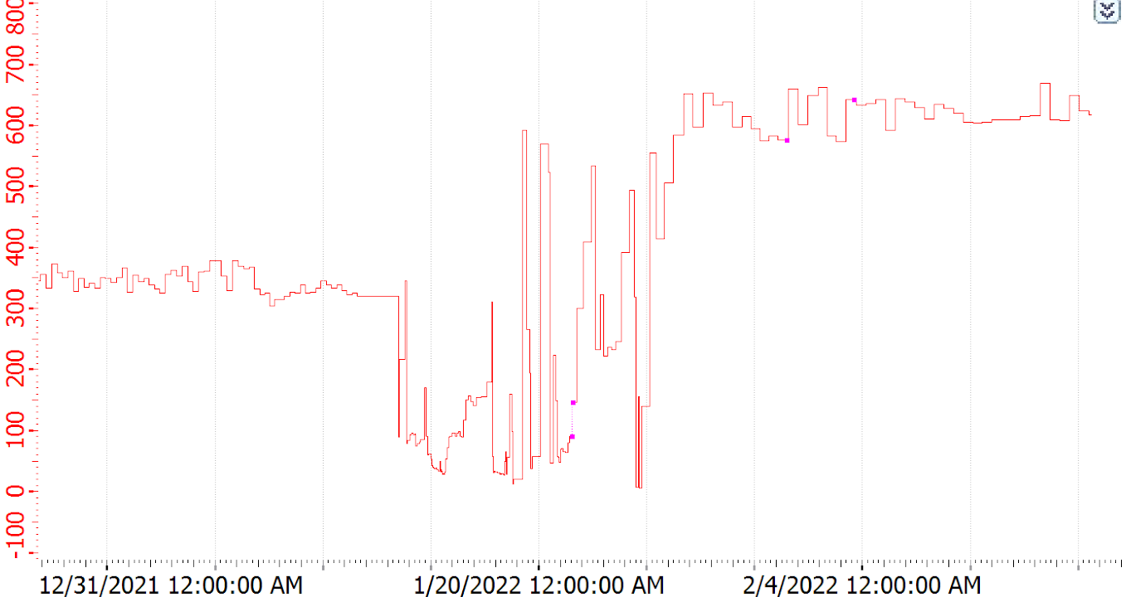
LBC33, LBC49, EBC48 and EBC49 fixation. 19-23 Jan
Maintenance of cooling station + EBC closer
11-12 January
PPV Cycle (min)
January-February 2022
EBC closed
24th January
EBC opening
13 January
Conflict with diffusion pump cables
LBC60 isolation valve rubber hose connection damaged by metallic PIN (on the EBC)
24th January

Slide 3
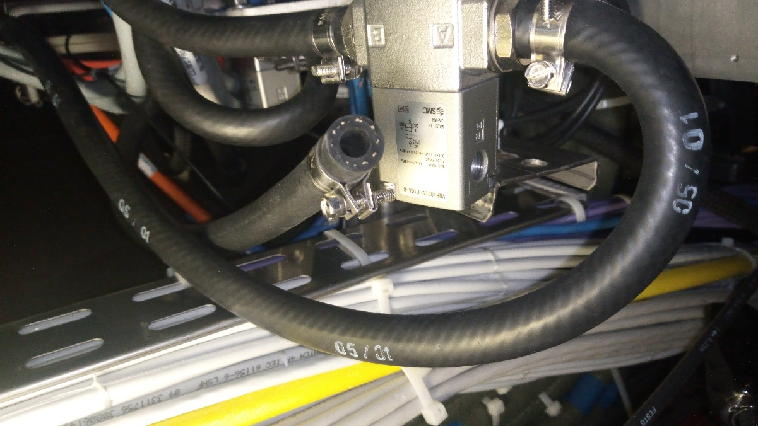
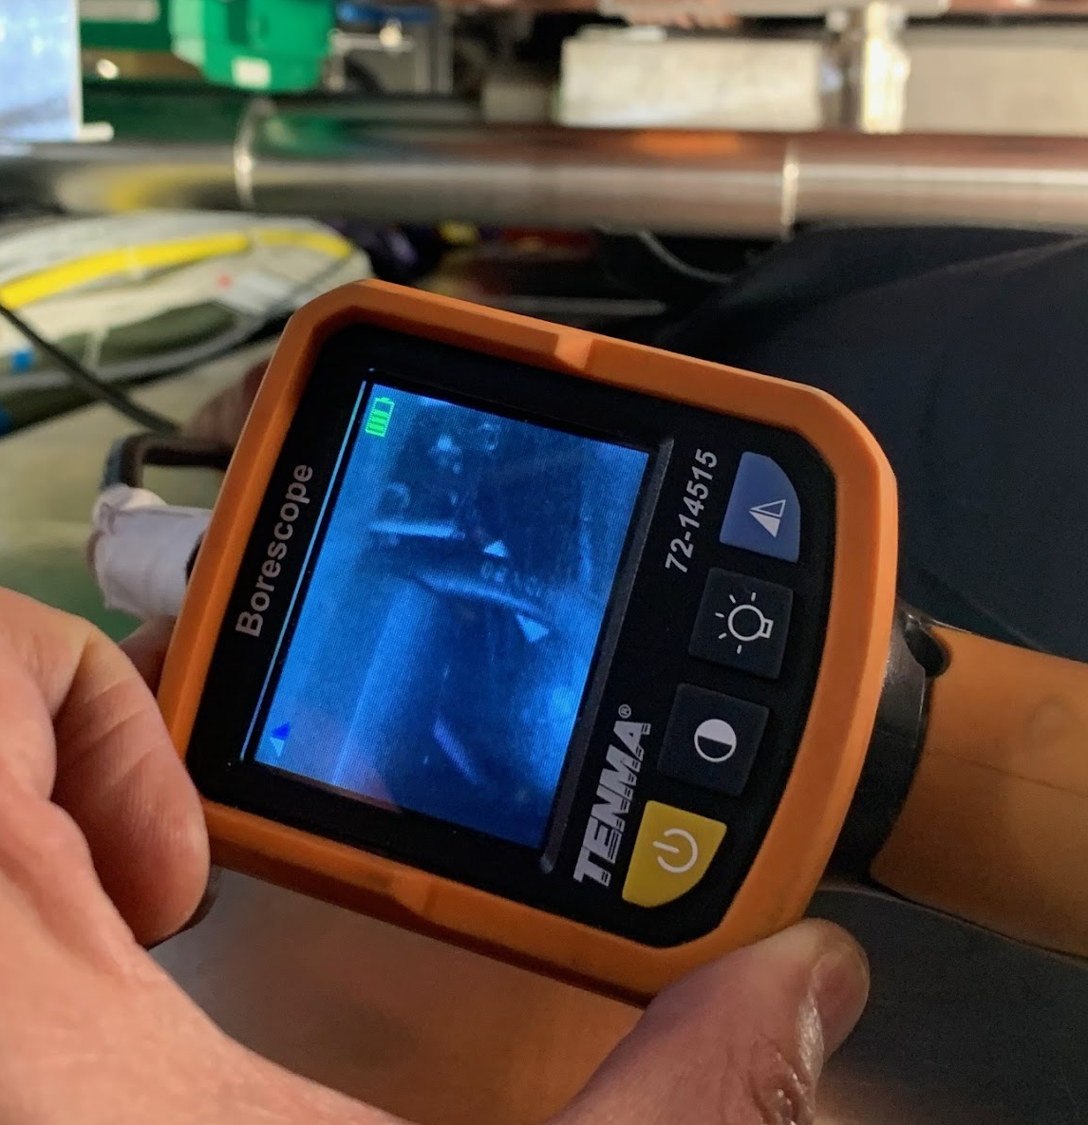
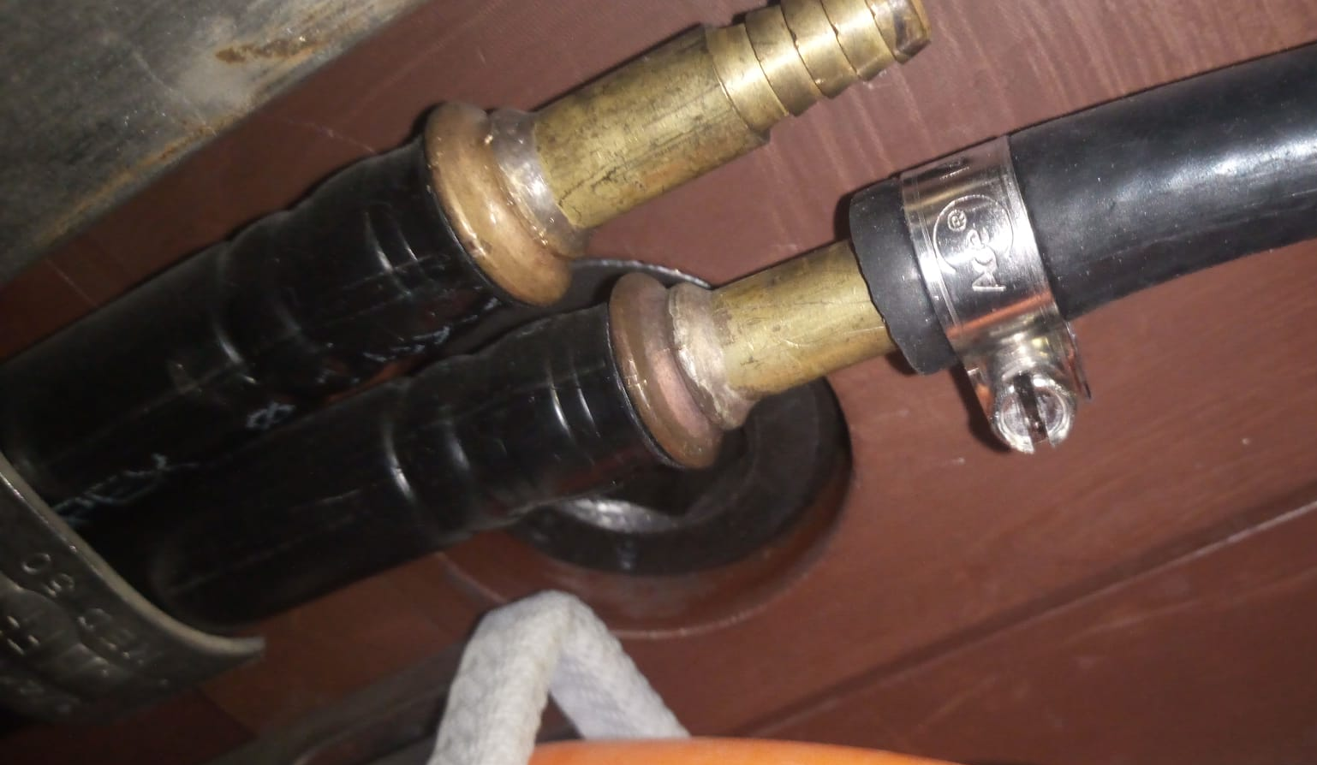
Rubber hose
Metallic PIN

Slide 4
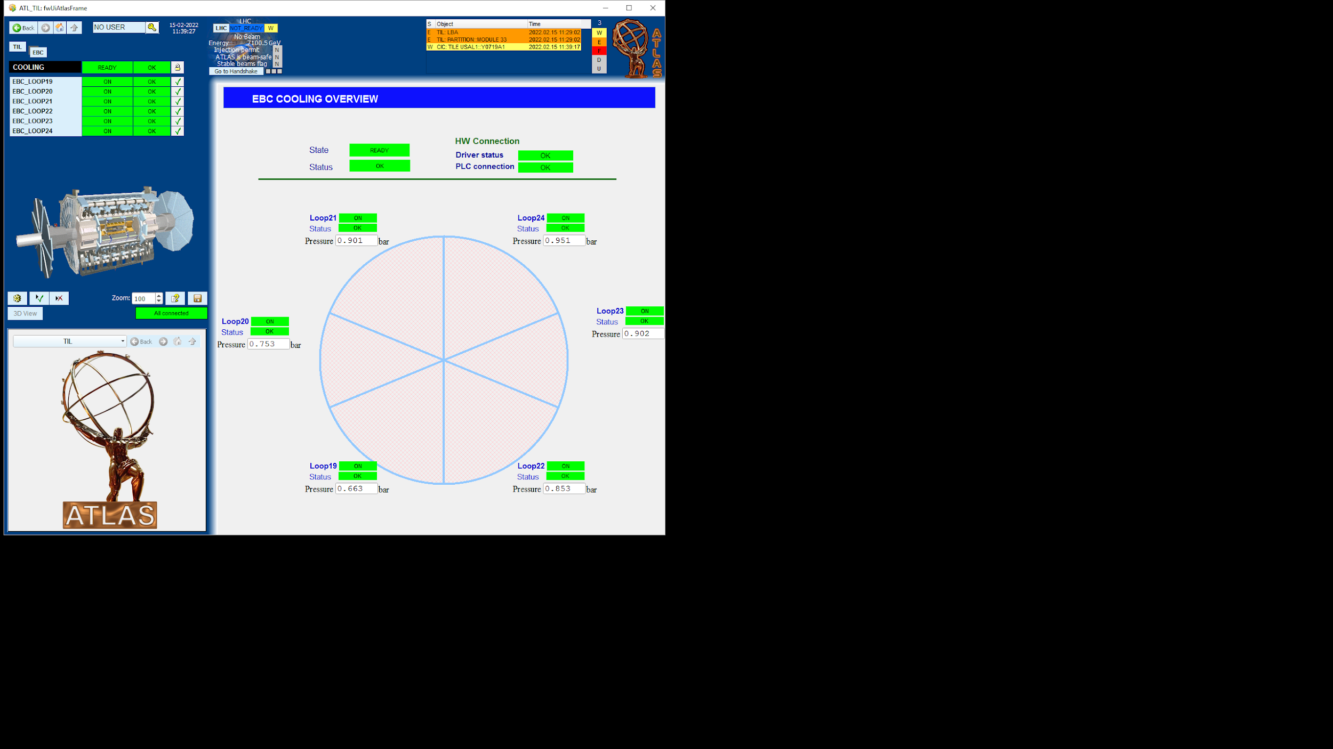

LBC60
LBC33
EBC49
EBC48
LBC49

Slide 5
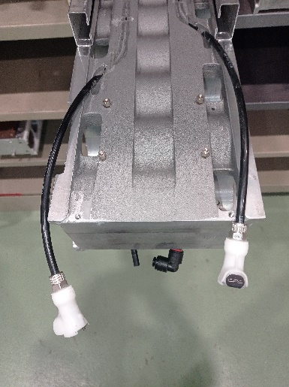
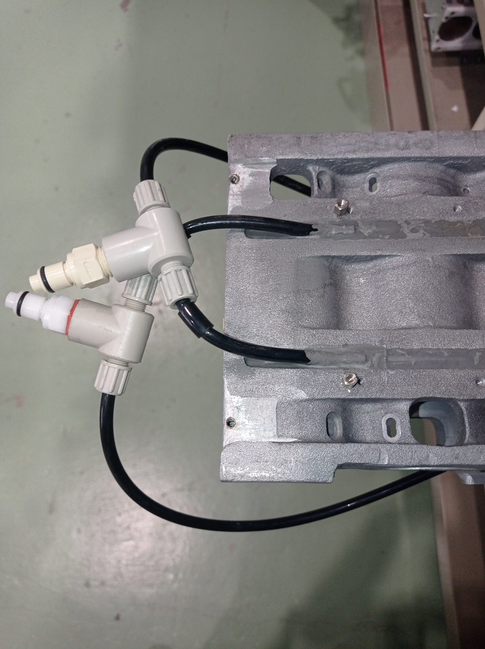
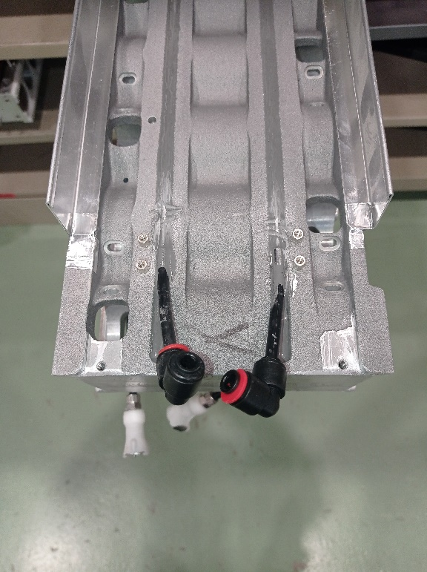
Internal Cooling of Tile Supper Drawer
MB-Side
IN
OUT
HV-Side

Slide 6
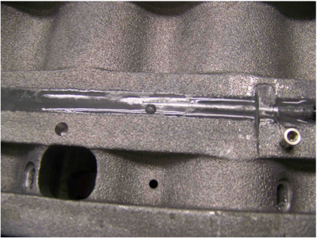
Cooling leak (EBA04) 2009
Metallic pipe corrosion

Slide 7
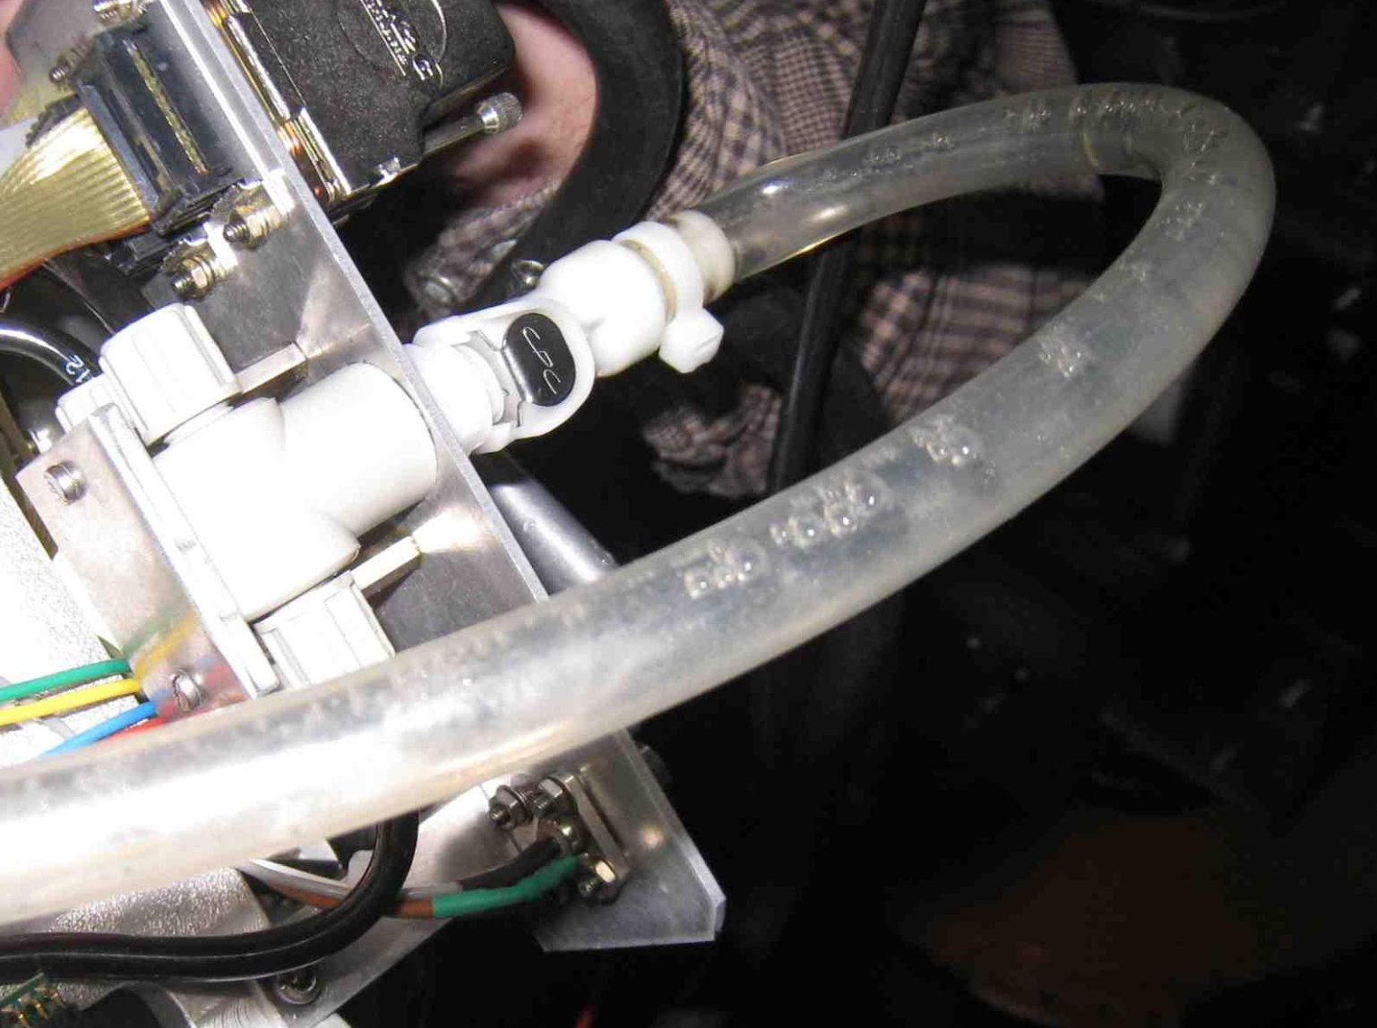
Some special cases (LBA 56) 2012
The water leak problem was in the internal drawer but was impossible to precisely located it.
After several days, SD was inserted but ¼ of the SD has no water flow (a bypass was installed preventing the water to flow in the internal drawer – MB side)
No increase in temperature is seen in DCS.
The PPV cycle of the cooling loop increased from 250 min to 350 min.
Air bubbles
PPV: Elapsed time between vacuum pump cycles.

Slide 8
 | Module | Date | From cooling disconnected | Impact in PPV cycle
1 | LBA56 | Jan. 2012 | MB internal | 100min (250🡪350min)
2 | EBA51 | March 2020 | ½ HV External | 30min
3 | LBC14 | April 2021 | MB external + HV internal | 100min
4 | LBC64 | Dec. 2021 | MB Internal + HV Internal | 50min
5 | LBC01 | Dec. 2021 | MB internal | 50min
6 | LBC33 | Jan. 2022 | HV side (internal + external) | 100min
7 | LBC49 | Jan. 2022 | HV side (internal + external) | 100min
8 | EBC48 | Jan. 2022 | HV side (internal + external) | 100min
9 | EBC49 | Jan. 2022 | HV side (internal + external) | 100min

Slide 9
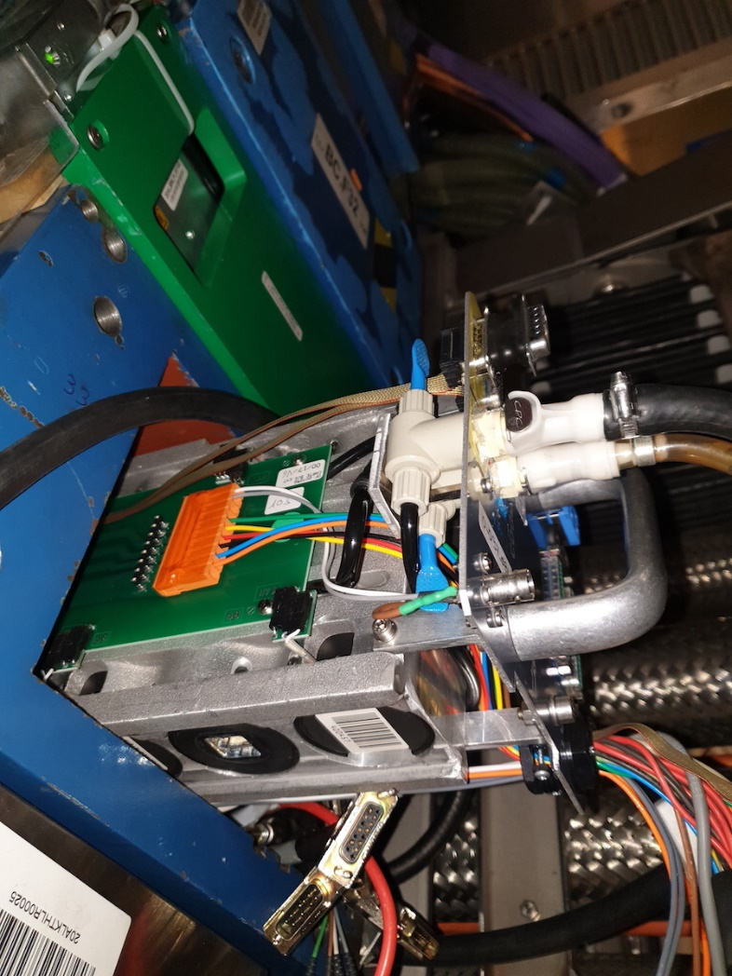
Internal Cooling of Tile Supper: Drawer HV side excluded
MB-Side
IN
OUT
HV-Side

